Slide 1
Know The Tech Around You
All about Tech

Slide 2
Demystifying Common Tech Terms
Frontend & Backend Development
Database
APIs
Deployment

Slide 3
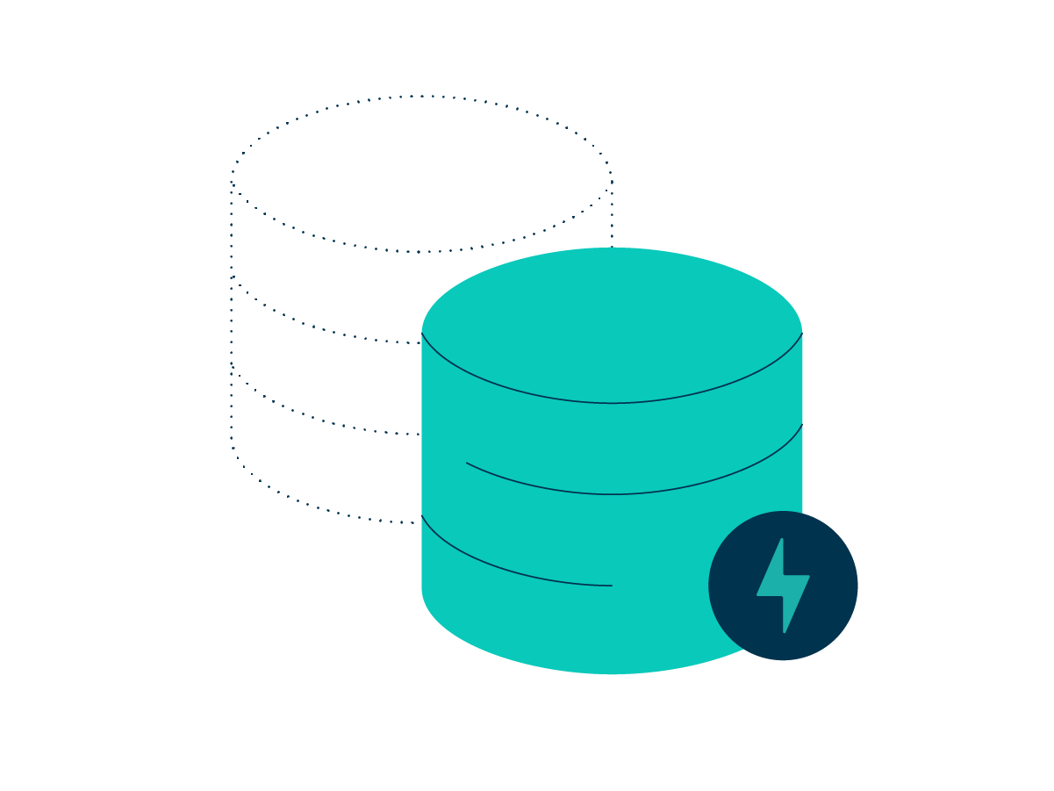
What is a Database?
Database definition & overview: It is an organized collection of data stored somewhere.
Platform specific databases
Browsers (session storage, cookies)
Mobile & Desktop Devices (sqlite, sql, mongoDB)
What is CRUD and how does it work?
See an example site of how CRUD works and why it is used in everyday TECH

Slide 4
What is an API?
API Definition and overview: API is the acronym for application programming interface — a software intermediary that allows two applications to talk to each other. APIs are an accessible way to extract and share data within and across organizations.
How API works by being a middleman

Slide 5
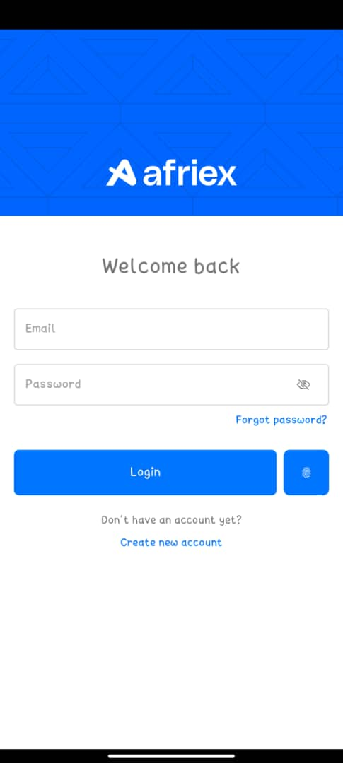
Frontend & Backend Development
Frontend Development definition & overview
Backend Development definition & overview
How frontend and Backend work together - APIs
Where your data goes to when you hit “signup” - C
What happens when you hit “login” - R
What happens when you change your name - U
What happens when you request for Deactivation - D

